Slide 1
Project-based introduction to scientific computing for physics majors
Jennifer L. Klay Department of Physics California Polytechnic State University San Luis Obispo

Slide 2
Outline
Background
Course Organization
Learning Assessment
Project Examples
Surveys and Course Assessment
Lessons Learned
Computing4Physics

Slide 3

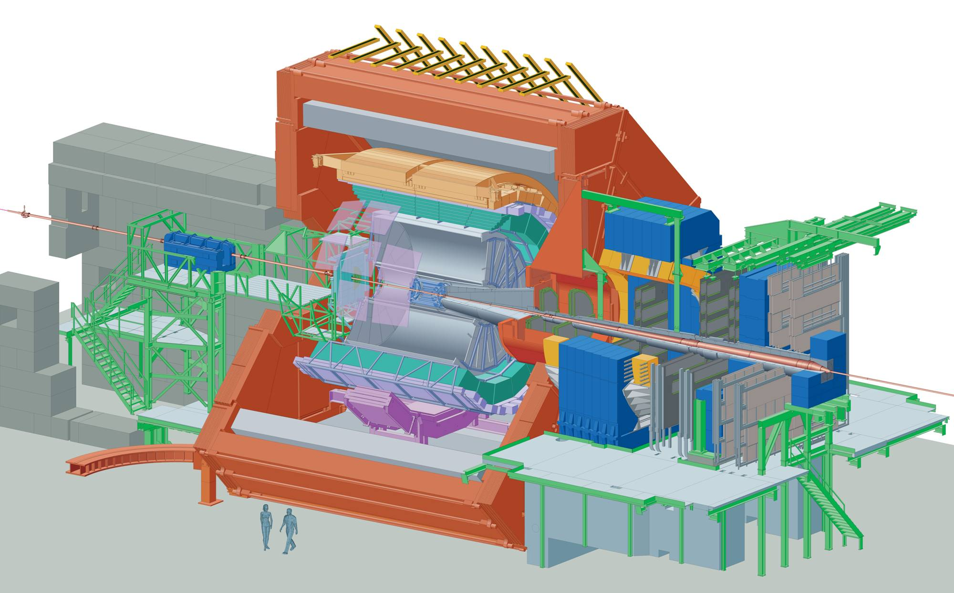
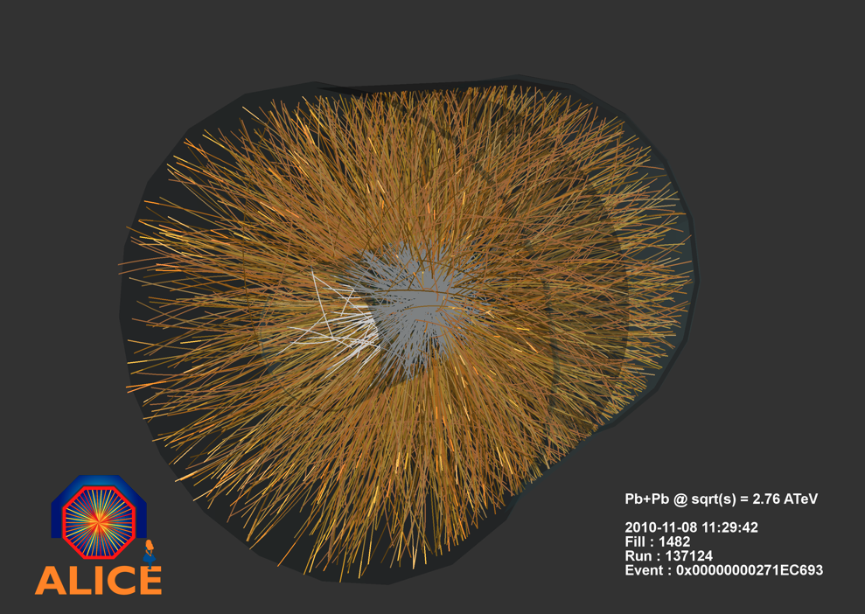
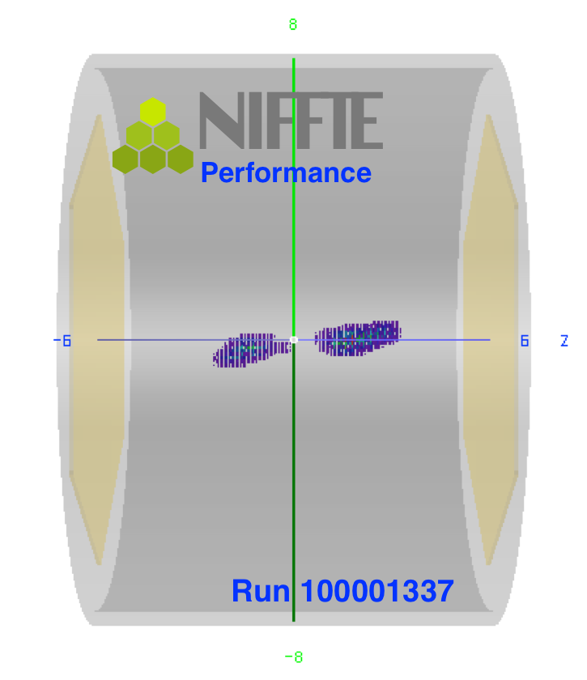
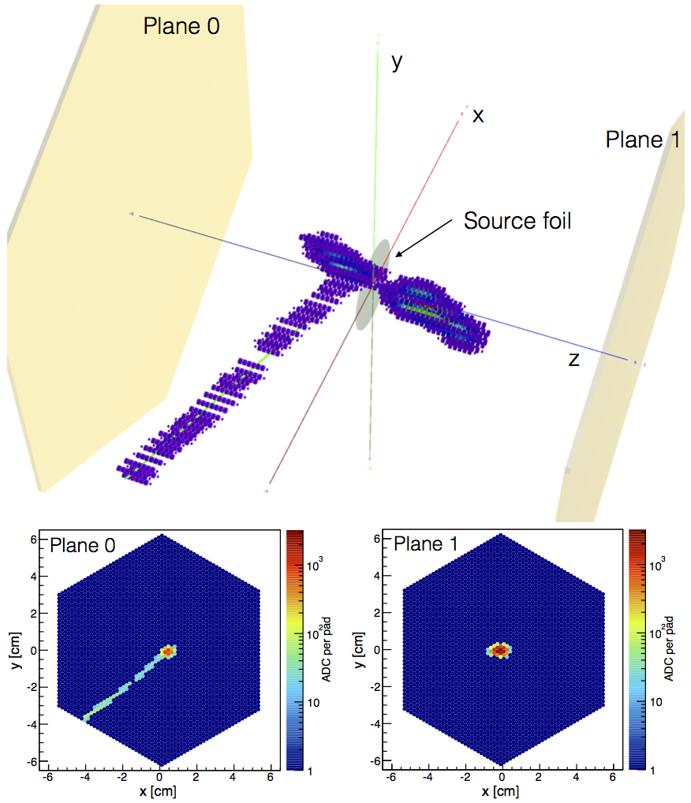

My background
Particle and Nuclear Physics
High energy nuclear collisions (RHIC, LHC)
Fission dynamics at LANL (low energy)
Software intensive
Fortran, Java, C/C++, shell scripting
PostgreSQL, cvs→svn→git
BIG DATA
Notes:
10 cm vs 10 m

Slide 4

Motivation
Programming for Everybody!
“Sorry, College Grads, I Probably Won't Hire You” If you're at all interested in media, technology or related fields, please learn a little computer programming. Kirk McDonald, WSJ Editorial, 09-May-2013.
But especially physicists…
Learn a language, any language
The basics are universal
The more you know, the easier they get…
Open source tools
Free! Open!
PHYSICS
Theory
Experiment
Computing

Slide 5
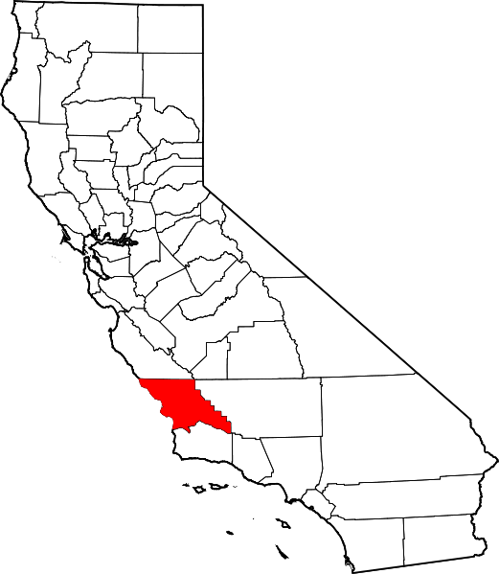


Cal Poly San Luis Obispo
California State University
“Learn by doing”
Senior Project Requirement
Student population: 19,000 (mostly undergraduates)
PHYSICS
~150 majors
~30 tenured/tenure-track faculty
APS/AAPT "SPIN-UP” recognition (2002, 2010) Strategic Programs for INovation in Undergraduate Physics

Slide 6
Scientific Computing in Physics at Cal Poly
“Physics on the Computer” since 1996 Introduction to using computers for solving problems in physics: differential equations, matrix manipulations, simulations and numerical techniques, nonlinear dynamics. 4 lectures.
Spring of sophomore year, after introductory physics and math
Traditionally Excel, Maple, MATLAB
No upper division electives in scientific computing or computational physics (yet)
Numerical and computational methods in upper division theory courses at instructor discretion
Multi-year effort in department to improve student training in computing since 2007

Slide 7
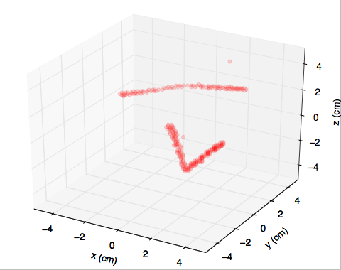
“Python for Physicists” (2012)
Independent study course, Spring 2012
Learn Python, code a cool project
35 students enrolled, 1 unit
Five weeks of “Think Python” by Allen Downey et al.
Five weeks of group projects
1-d traffic flow (theoretical)
3-d particle trajectory reconstruction (experimental)
Final project demos
{x_{i},v_{i} i=0,…,N-1}
v₁
0
1
2
3
4
…
L-1

Slide 8
Program Learning Outcomes (2013)
Programming
Use basic coding concepts such as loops, control statements, variable types, arrays, array operations, and boolean logic
Write, run and debug programs in a high level language
Carry out basic operations (e.g. cd, ls, dir, mkdir, ssh) at the command line
Numerical Methods
Use numerical algorithms (e.g. ODE solvers, FFT, Monte Carlo) and be able to identify their limitations
Code numerical algorithms from scratch and compare with existing implementations
Symbolic Analysis
Use symbolic analysis to solve algebraic, integral, and differential equations
Visualize symbolic analytic expressions

Slide 9
Program Learning Outcomes (2013)
Data (Remote, Local, Instrument)
Read from and write to local or remote files
Analyze data. For example, curve fitting, statistical tests, spectral methods
Visualize data. For example, multidimensional plots, animation, contour plots
Create publication/presentation quality graphics, equations
Instrument control and data acquisition
Read data into computer from a variety of sources
Use computer to control external instruments

Slide 10
“Physics on the Computer” Learning Objectives
Use basic coding concepts such as loops, control statements, variable types, arrays, array operations, and boolean logic. (LO1)
Write, run and debug programs in a high level language. (LO2)
Carry out basic operations (e.g. cd, ls, dir, mkdir, ssh) at the command line. (LO3)
Maintain a version controlled repository of your files and programs. (LO4)
Create publication/presentation quality graphics, equations. (LO5)
Visualize symbolic analytic expressions - plot functions and evaluate their behavior for varying parameters. (LO6)
Use numerical algorithms (e.g. ODE solvers, FFT, Monte Carlo) and be able to identify their limitations. (LO7)
Code numerical algorithms from scratch & compare w/ existing implementations. (LO8)
Read from and write to local or remote files. (LO9)
Analyze data using curve fitting and optimization. (LO10)
Create appropriate visualizations of data, e.g. multidimensional plots, animations, etc. (LO11)

Slide 11

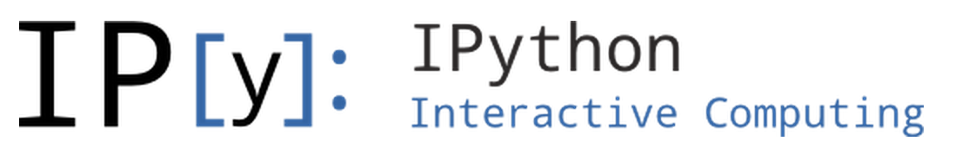
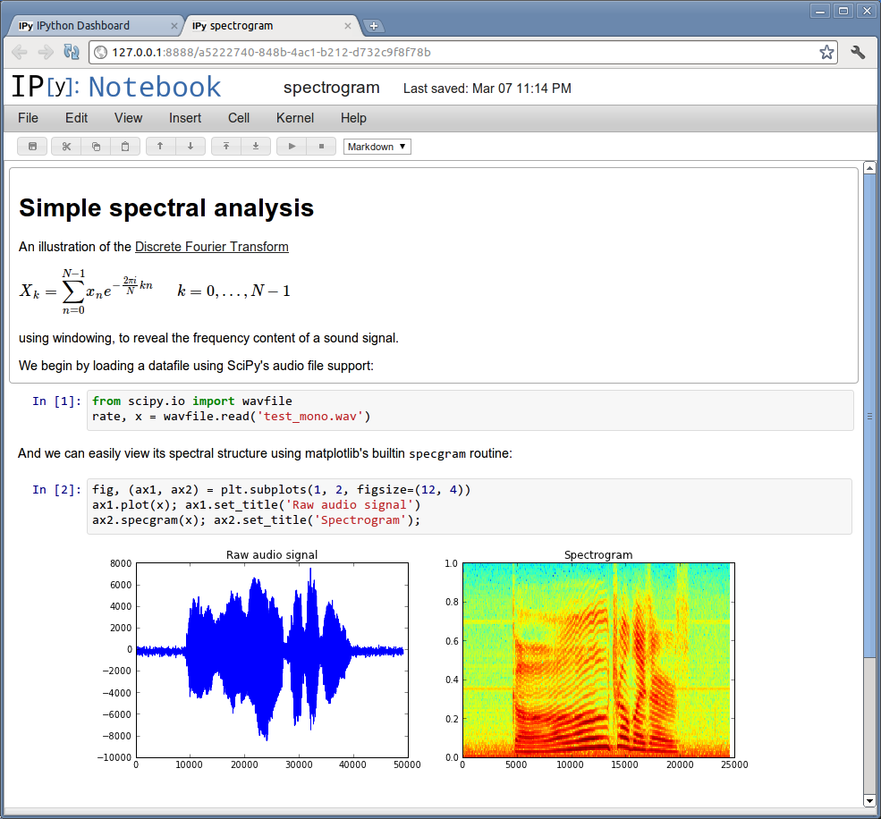







Course Organization
Materials
Schedule
Assessment
Projects

Slide 12
Schedule
Week | Topics | Learning Objectives
1 | Programming Bootcamp (Codecademy) UNIX Shell, Version Control | LO1, LO2, LO3, LO4
2 | Programming Bootcamp (Codecademy) IPython Notebook, ssh, ipythonblocks | LO1-4, LO11
3 | Intro to NumPy, SciPy, Data I/O | LO1-4, LO9, LO11
4 | Graphics, Animation and Error Handling | LO1-4, LO5, LO6, LO11
5 | Midterm Exam, Projects, Program Design | LO1-6, LO9
6 | Interpolation and Differentiation | LO1-6, LO7, LO8, LO11
7 | Numerical Integration & Ordinary Differential Equations | LO1-8, LO11
8 | Random Numbers and Monte Carlo Methods | LO1-8, LO11
9 | Linear Regression and Optimization | LO1-11
10 | Symbolic Analysis and Project Hack-a-thon | LO1-6, LO11
Finals | Project Demos | LO1-11

Slide 13
Grading Logistics
Points | Description
5 | Goes above and beyond. Extra neat, concise, well-commented code, and explores concepts in depth. (“A+/A”)
4 | Complete and correct. Includes an analysis of the problem, the program, verification of at least one test case, and answers to questions, including plots. (“A/A-”)
3 | Contains a few minor errors. (“B”)
2 | Only partially complete or has major errors. (“C”)
1 | Far from complete. (“D”)
0 | No attempt. (“F”)
Approximately 40 students
x 10 Project Euler problems
x 12 Assignments
x 1 Midterm exam
x 1 Project (30% of grade)
= A LOT of grading
Grader for Project Euler
Automated assessment?
Academic Honesty Guidelines

Slide 14
Projects
2012: as groups, with project demos
1-d Traffic Flow
3-d Particle Tracking
2013: as individuals, no demos
1-d Traffic Flow
3-d Particle Tracking
Monte Carlo Glauber Model of Nuclear Collisions
Cosmic Ray Air Shower Simulation and Multi-lateration
2014: as individuals, with demos
Schelling Model of Segregation with ipythonblocks (NIFTY)
Estimating Avogadro’s Number with Brownian Motion (NIFTY), building on Software Carpentry Multimedia lesson
Simulating Galaxy Mergers and Interactions with odeint

Slide 15
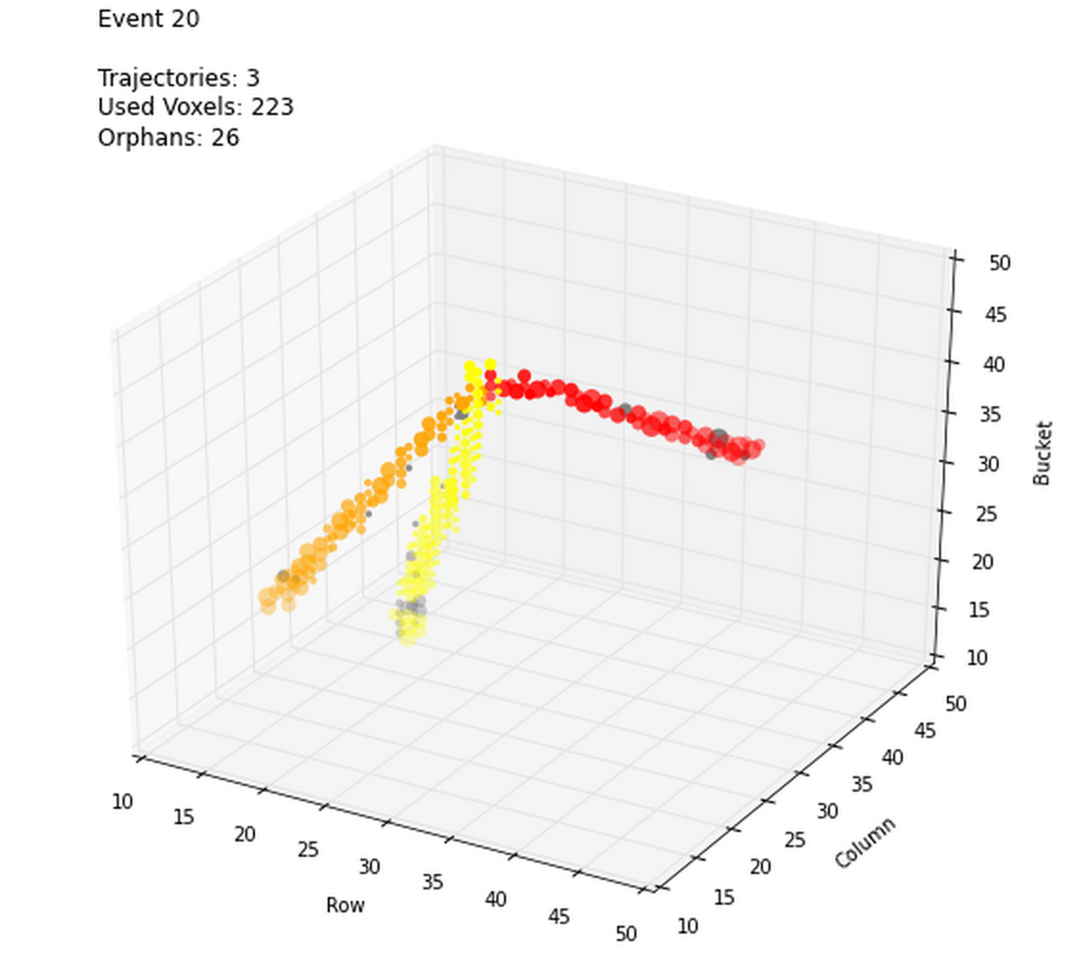
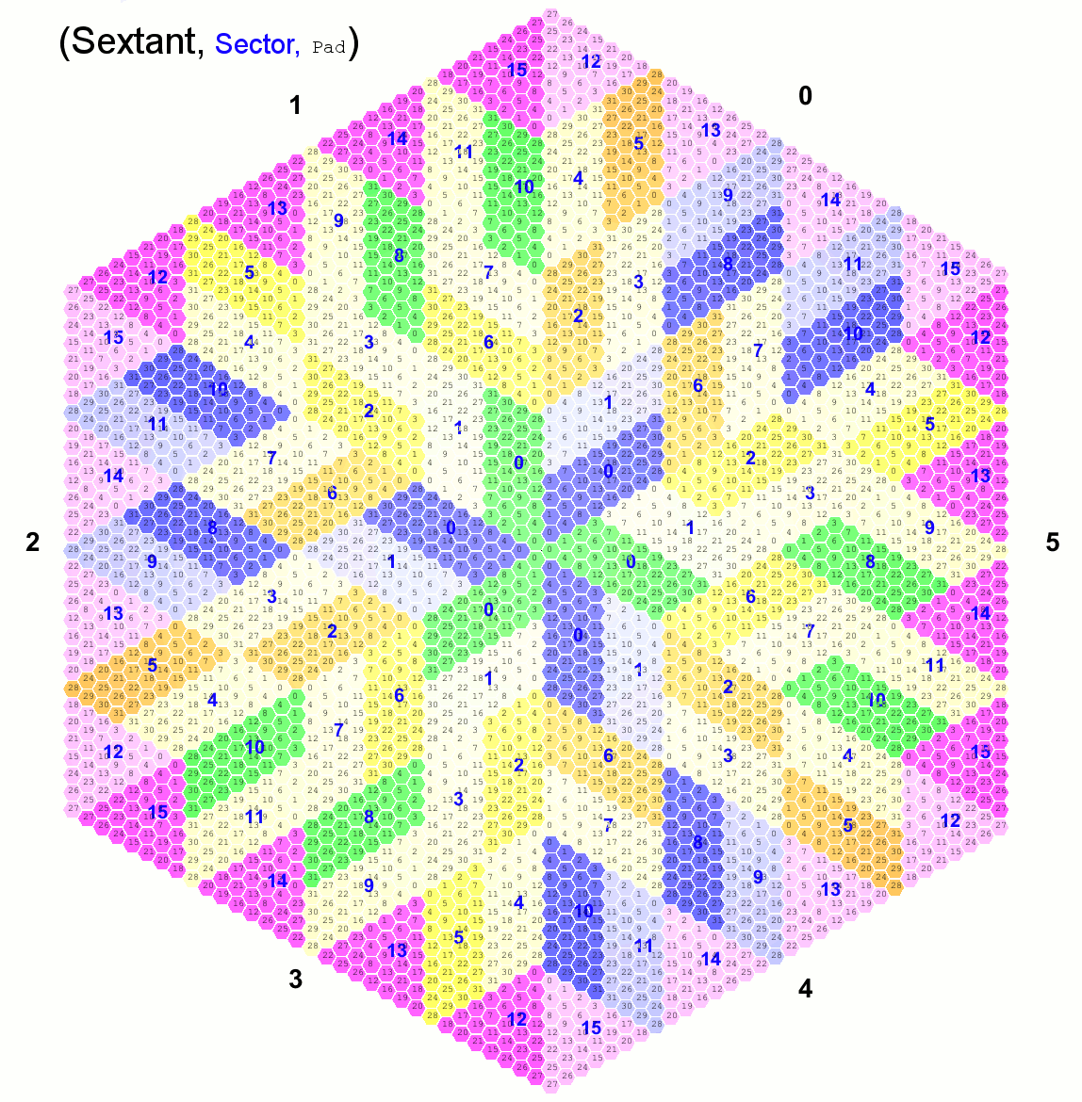
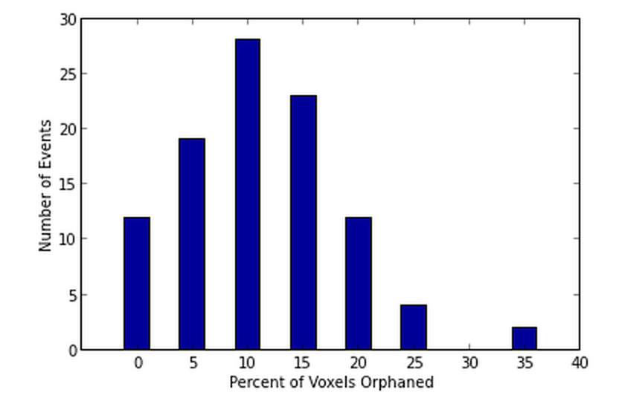
3-d Particle Tracking
Sparse data, hexagonal voxels

Slide 16
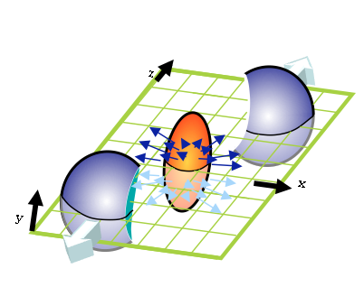
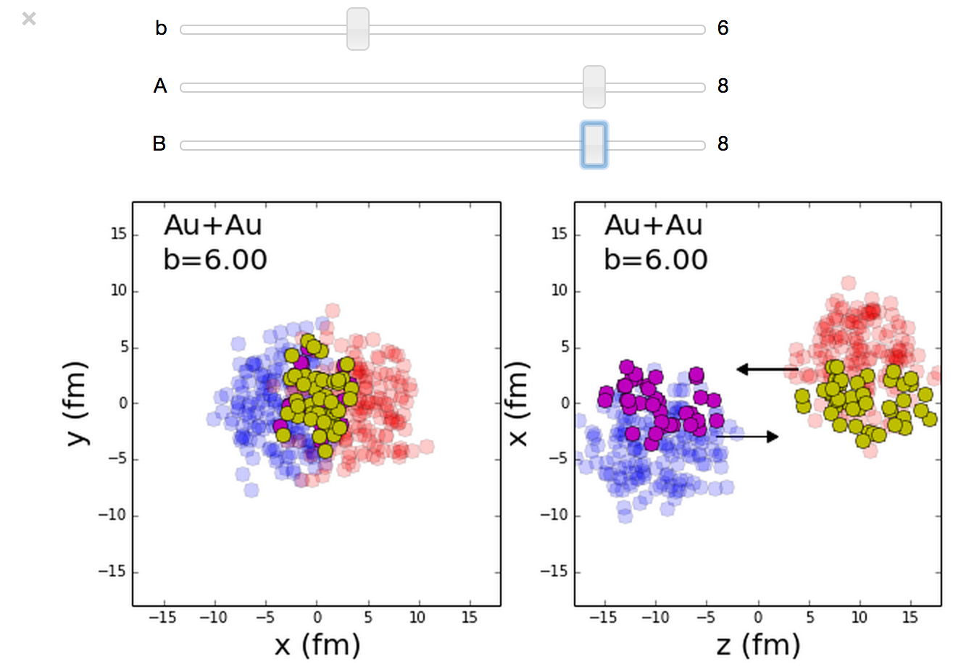
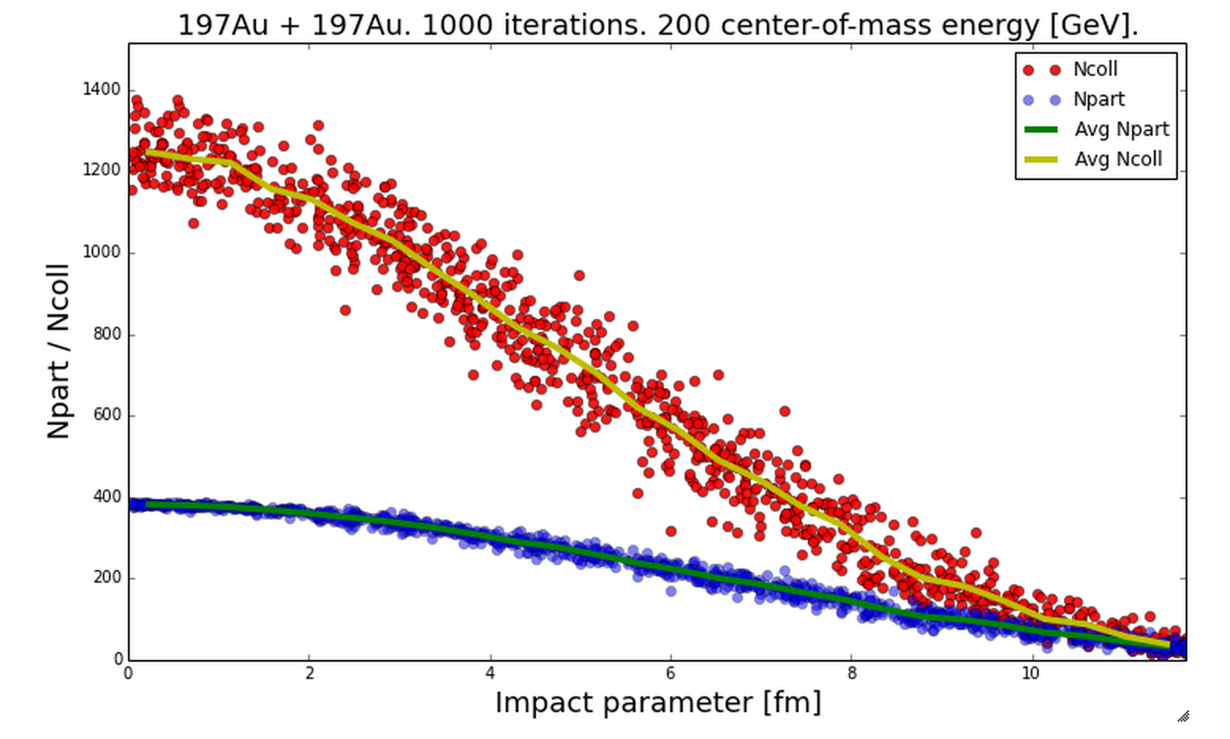
Monte Carlo Glauber Model
Nuclear Collision Geometry
MCGlauber Project on GitHub

Slide 17
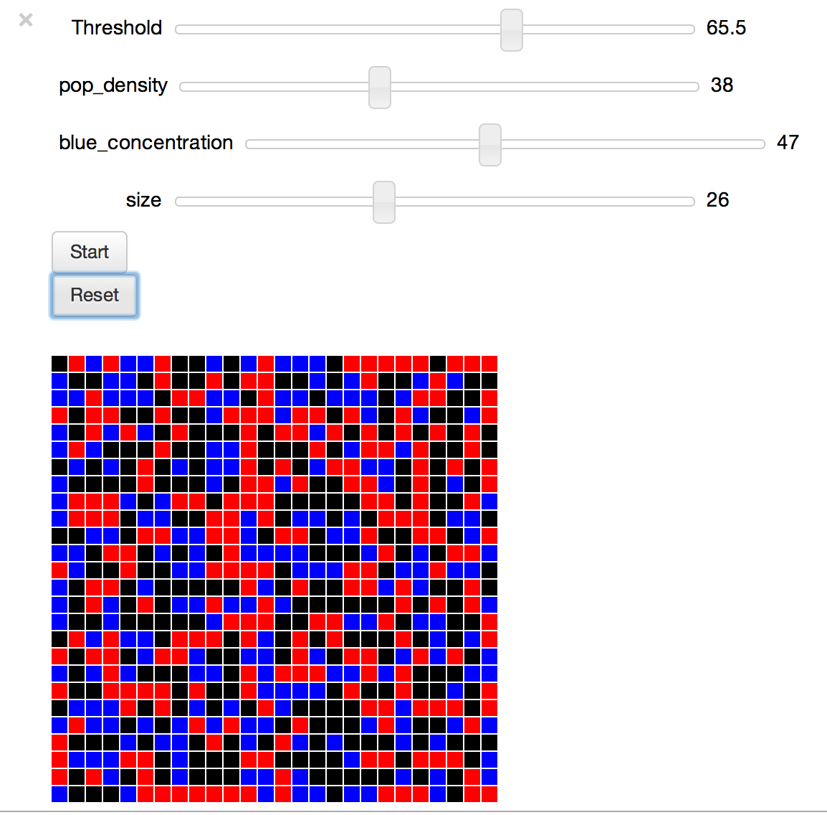
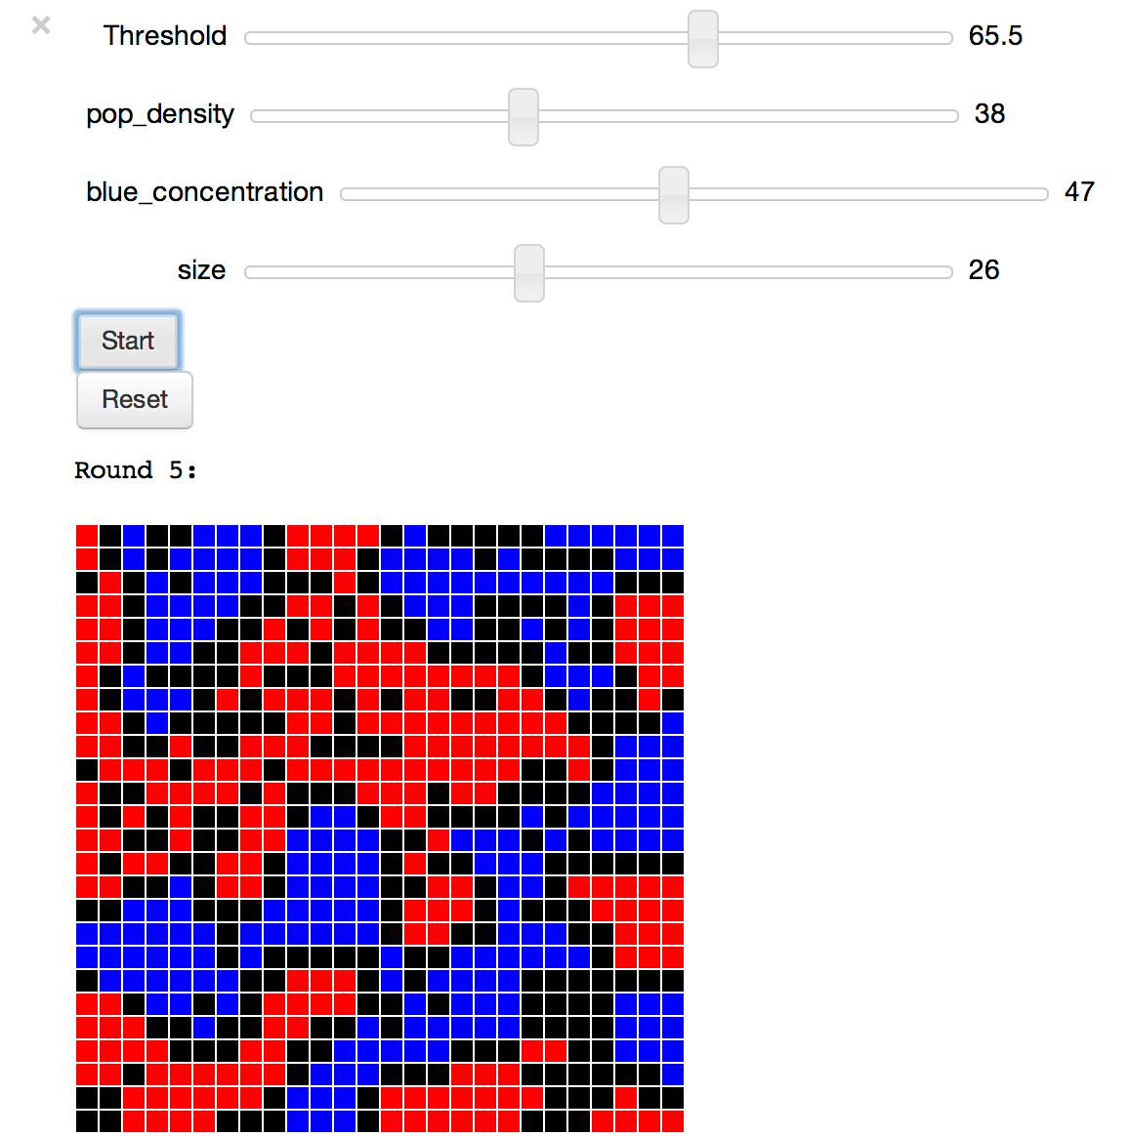
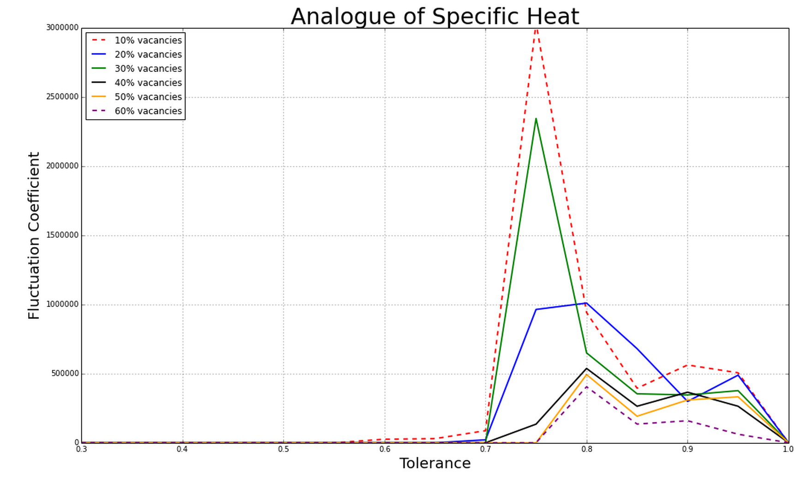
Schelling Model
Economist Thomas Schelling’s 1971 model of racial segregation
Based on Frank McCown’s Stanford NIFTY assignment
Interactive widget created with ipythonblocks
Analysis of “thermodynamic” properties

Slide 18
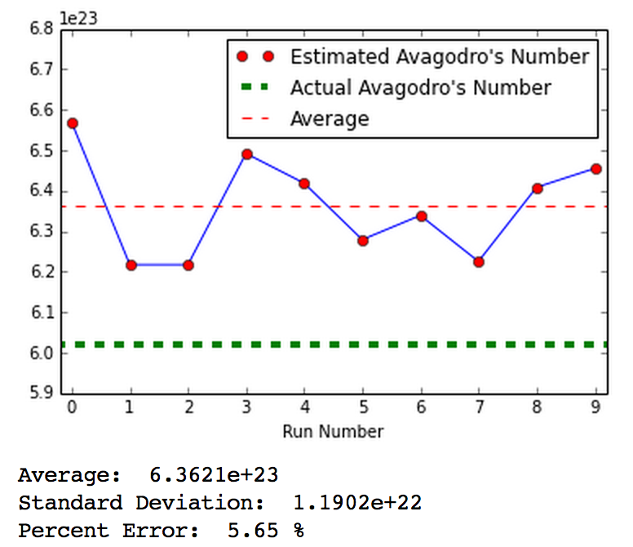
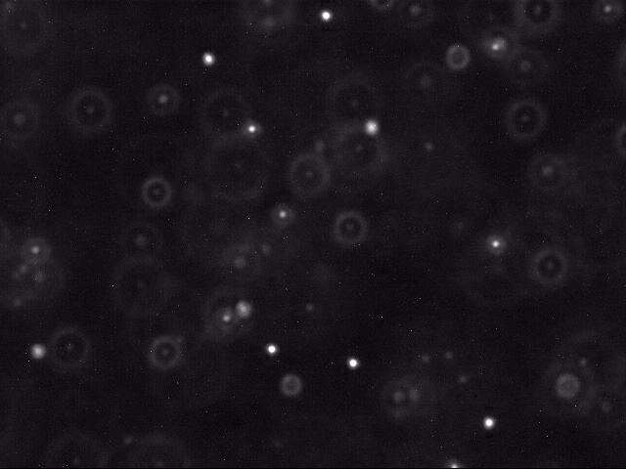
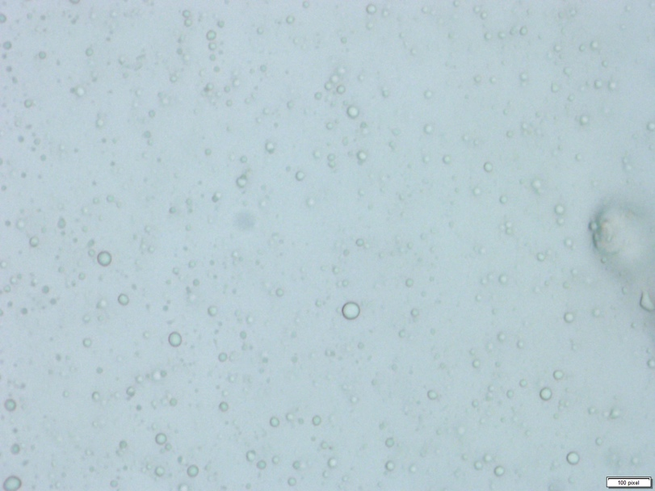
Avogadro’s Number from Brownian Motion
Kevin Wayne’s Stanford NIFTY assignment
Particle identification and tracking in video frames
Built on Software Carpentry Multimedia Lesson
Data Collection and Analysis
Video microscopy
Polystyrene beads
Milkfat globules

Slide 19
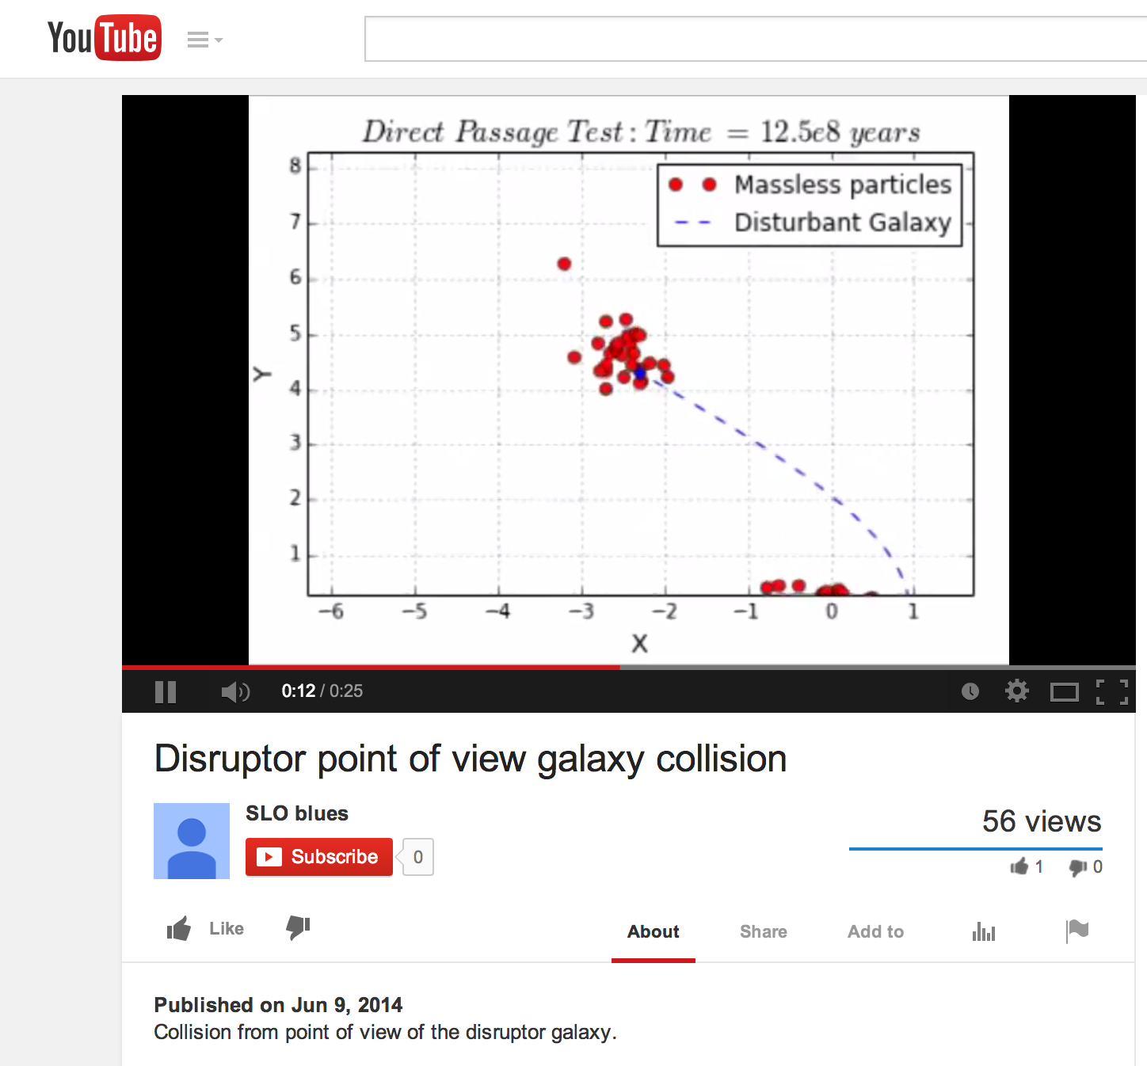
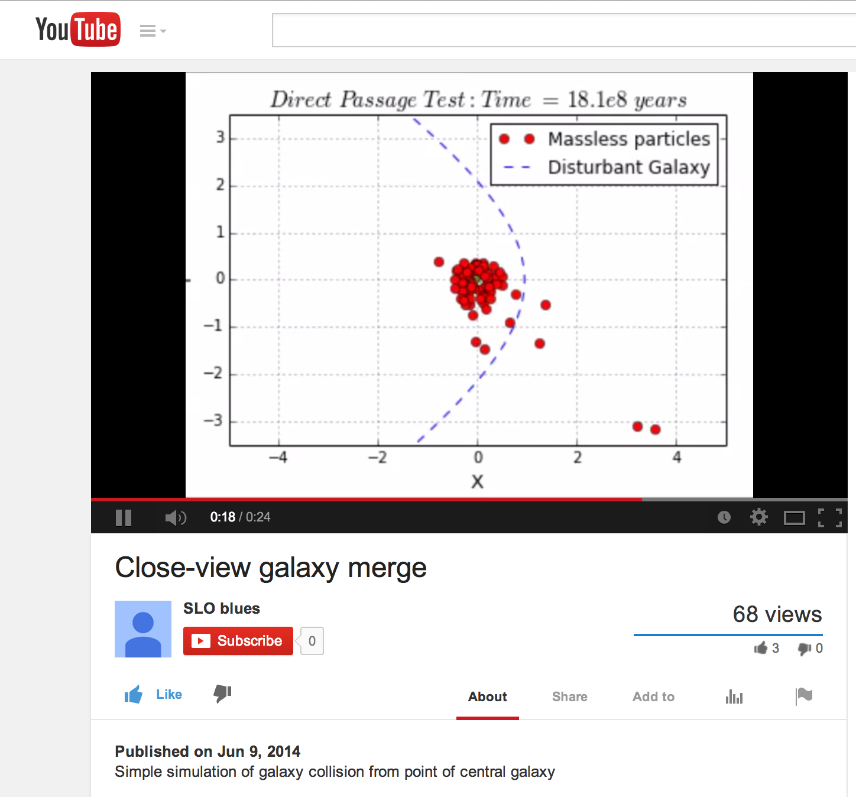
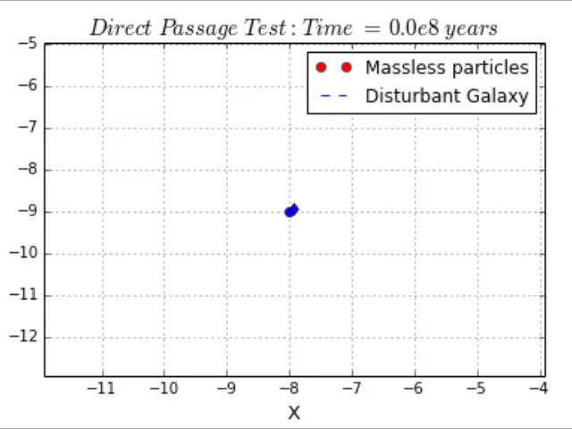
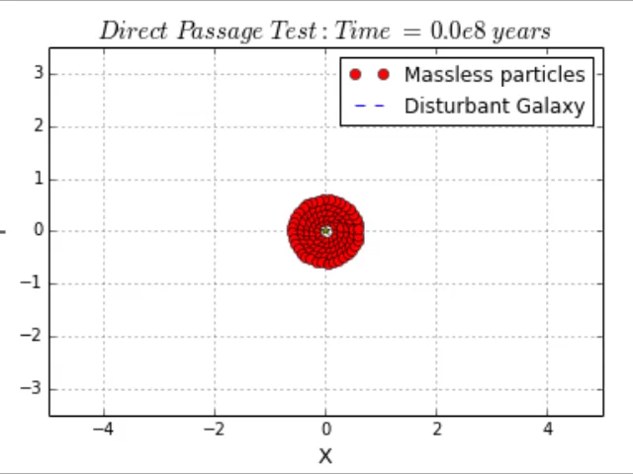
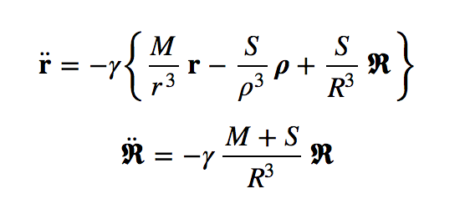
Galaxy Mergers
Restricted N-body problem (Toomre & Toomre 1972)
M = Main galaxy core
S, R = Disruptor galaxy core
r_{i} = massless point particles orbiting M
ρ_{i} = R-r_{i}
Parabolic Passage of Disruptor

Slide 20
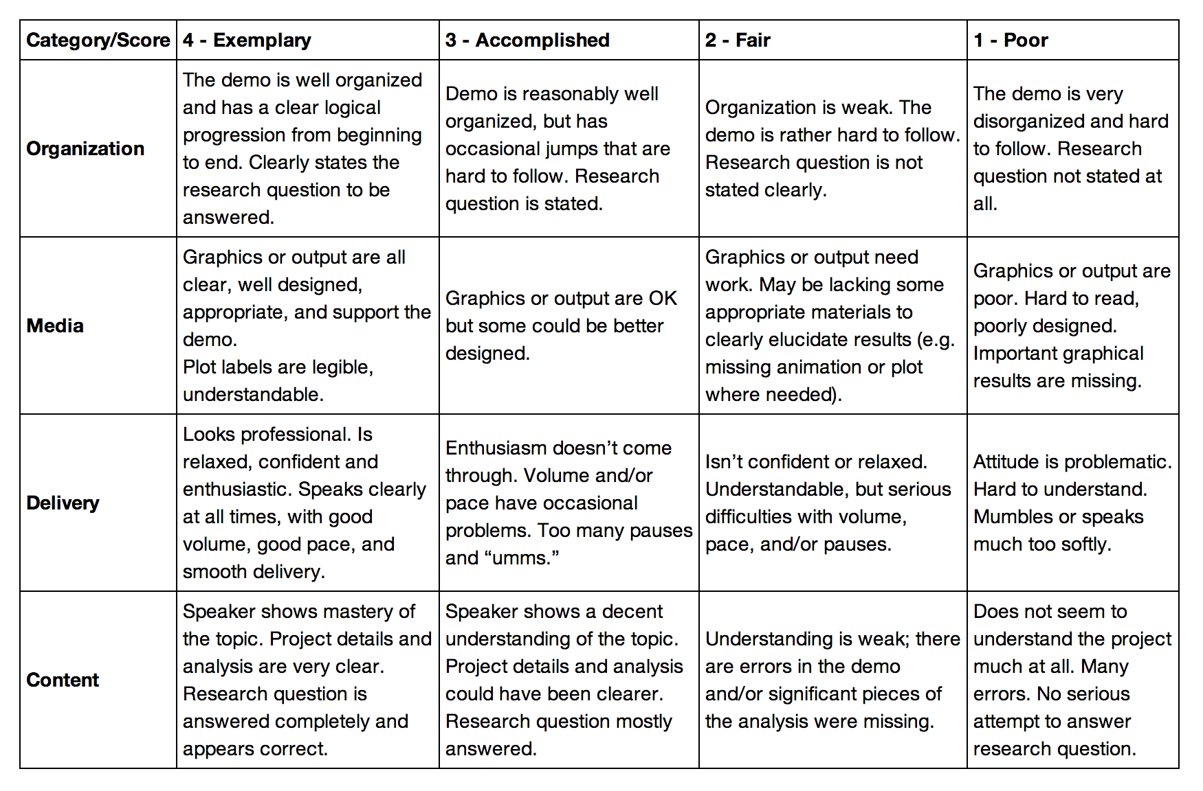
Project Demos
5-7 minute oral presentation of assigned personalized research question during scheduled final exam
Peer evalution
Organization
Media
Delivery
Content
Impressive effort by the students

Slide 21
Pre- and Post- Assessment
Pre-learner survey (from Software Carpentry) was used to assess student preparedness
Four questions repeated on pre- and post- assessment surveys
Additional post assessment:
Relevance of course material to subsequent courses and career?
"Extremely useful, essential to my success" (21/34 and 20/34) or "Useful but not essential" (12/34 and 11/34)
How many hours per week outside of class?
Almost all said 5-6 hours, half (17/34) said more than 10 hours

Slide 22
Pre/Post Assessment Question 1
With which programming languages could you write a program from scratch that reads a column of numbers from a text file and calculates mean and standard deviation of that data? (Check all that apply)
Language | Pre | Post
Fortran | 0/42 | 1/34
C | 5/42 | 7/34
C++ | 6/42 | 5/34
Perl | 0/42 | 0/34
MATLAB | 5/42 | 1/34
Python | 3/42 | 31/34
R | 1/42 | 1/34
Java | 7/42 | 5/34
Others (list) | 7/42 (Labview) | 1/34
None | 20/42 | 2/34

Slide 23
Pre/Post Assessment Question 2
In the following scenario, please select the answer that best applies to you. A tab-delimited file has two columns showing the date and the highest temperature on that day. Write a program to produce a graph showing the average highest temperature for each month.
Answer | Pre- | Post-
I could not complete this task. | 19/42 | 3/34
I could complete the task with documentation or search engine help. | 22/42 | 13/34
I could complete the task with little or no documentation or search engine help. | 1/42 | 18/34

Slide 24
Pre/Post Assessment Question 3
In the following scenario, please select the answer that best applies to you. Given the URL for a project's version control repository, check out a working copy of that project, add a file called notes.txt, and commit the change.
Answer | Pre- | Post-
I could not complete this task. | 42/42 | 2/34
I could complete the task with documentation or search engine help. | 0/42 | 17/34
I could complete the task with little or no documentation or search engine help. | 0/42 | 15/34

Slide 25
Pre/Post Assessment Question 4
How would you solve this problem? A directory contains 1000 text files. Create a list of all files that contain the word "Drosophila" and save the result to a file called results.txt.
Answer | Pre- | Post-
I could not create this list. | 35/42 | 3/34
I would create this list using “Find in Files” and “copy and paste”. | 2/42 | 0/34
I would create this list using basic command line programs. | 4/42 | 2/34
I would create this list using a pipeline of command line programs. | 1/42 | 2/34
I would create this list using some Python code and the ! escape. | N/A** | 19/34
I would create this list with code using the Python ‘os’ and ‘sys’ libraries. | N/A** | 8/34
**Note: the last two options were included in the post-survey only

Slide 26
Course Learning Objectives?
Students were asked to rate how well the course met the learning objectives.
“Completely” or “mostly” met all of them…
LO7 - Use numerical algorithms (e.g. ODE solvers, FFT, Monte Carlo) and be able to identify their limitations.
LO8 - Code numerical algorithms from scratch & compare w/ existing implementations.
LO10 - Analyze data using curve fitting and optimization.
…could be covered more thoroughly
Students requested more “lecture” time

Slide 27
Loose ends and open questions
GitHub Usage
“Retention” from 2013 ~23%
Group projects vs. individual projects
Tours vs. verbal instruction
Pre-class preparation (flipped)
Intro vs. advanced topics, intro vs. advanced course, elective vs. required
More pair programming
Academic honesty

Slide 28

Computing4Physics
Available on GitHub, welcoming collaboration and contributions
Student content
Installation Guides
Tours and Exercises
Instructor Resources
Syllabus, Schedule, Surveys, Evaluations, Scripts
Detailed day-by-day breakdown of class time
(Solutions available on request)
Collaborative tools for better achieving educational goals

Slide 29
Summary
IPython and the IPython Notebook are great tools for teaching programming and computing to physics majors
Open-source, industry demand for skills, applicable to many fields
Project-based courses engage students in complex, open-ended problem solving
Oral presentations/demonstrations provide stronger motivation to complete goals
Projects can be jumping off points for more advanced research
Creating freely available collaborative tools and lessons can simplify the challenge of providing critical training

